Slide 1
Introduction to Next Generation Sequencing for Metagenomic Samples
Leah Catchpole and Kirsten McLay
Platform and Pipelines Division

Slide 2
Platforms and Pipelines Workflow
Project Management
Sample Receipt and QC
Library Construction
Sequencing Operations
Preliminary Analysis
P&P Project Management
P&P Operations
P&P Bioinformatics

Slide 3

Overview
Illumina Library Construction
Automated Library Construction
PacBio Library Construction
Sample QC
Application
Portfolio

Slide 4
Sample Quality Control
Two major important factors:
Quality
DNA: RNA free, High molecular weight, free of contaminants such as Ethanol, Phenol, proteins
RNA: clean (not degraded), stored at -80ºC
Quantity
Appropriate quantification essential
Nanodrop versus Qubit

Slide 5
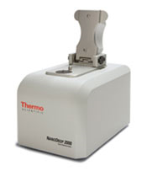
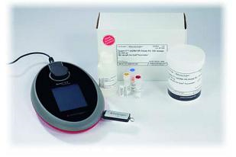
Sample Quality Control
 | NanoDrop® ND-1000 | Qubit® 2.0 Fluorometer
Quantitation Method | UV absorbance measurements (measures 260nm/280nm ratio) | Fluorescence-based dyes that bind specifically to DNA, RNA or protein
Selectivity for DNA or RNA | Results for samples containing both DNA and RNA are non discriminatory—you cannot distinguish one from the other | Accurately measure both DNA and RNA in the same sample
Accuracy and Precision at Low Concentrations | Significantly overestimates the measurement with the same sample—variation is often high | Accurately quantitates DNA in samples with concentrations as low as 10 pg/μL
Sensitivity and Range | Covers a sample concentration range of 2 ng/μL to 15 μg/μL | Tolerates 1–20 μL of sample. The effective range covers a sample concentration range of 10 pg/μL to 1 μg/μL DNA
X
✔

Slide 6
Qubit / Plate Reader – DNA
For new DNA samples the concentration is measured using a Broad Range assay.
The concentration must be high enough for the downstream applications of the DNA:
TruSeq DNA – 1ug DNA in 55ul
TruSeq PCR Free – 1ug/2ug DNA in 55ul (depending on size)
TruSeq Nano – 100ng/200ng DNA in 55ul (depending on size)
Nextera XT – 1ng DNA in 5ul
Nextera Mate Pair – 4-15ug DNA in 100ul (depending on size)
KAPA Library Prep – 1ug DNA in 55ul
NEBNext Library Prep – 1-5ug DNA in 55ul
NEBNext Ultra Library Prep – 5ng-1ug DNA in 55ul

Slide 7
Qubit / Plate Reader – RNA
For new RNA samples the concentration is measured using an RNA assay.
The concentration must be high enough for the downstream applications of the RNA:
TruSeq RNA – 1ug RNA in 50ul
Ribo Zero – 2.5ug RNA in a max. of 28ul

Slide 8
Qubit / Plate Reader – RNA
When measuring the concentration of RNA in RNA samples, the DNA must also be measured using the High Sensitivity assay.
A significant amount of DNA can have a negative impact on RNA library construction.
The RNA is passed or failed based on the ratio of DNA to RNA, rather than having a set DNA concentration that would cause a fail.

Slide 9
Sample QC – RNA
Performed on either:
an RNA chip on the GX
A Nano/Pico chip on the Bioanalyser
Make sure that the RNA has not degraded and that is it of a good quality.
The RIN number of the RNA should be 7 or above to PASS, however, the best way to decide if RNA is of good quality is by looking at the trace. N.B. On occasion the RIN number has been high but the trace may look poor - never solely trust the RIN number.

Slide 10
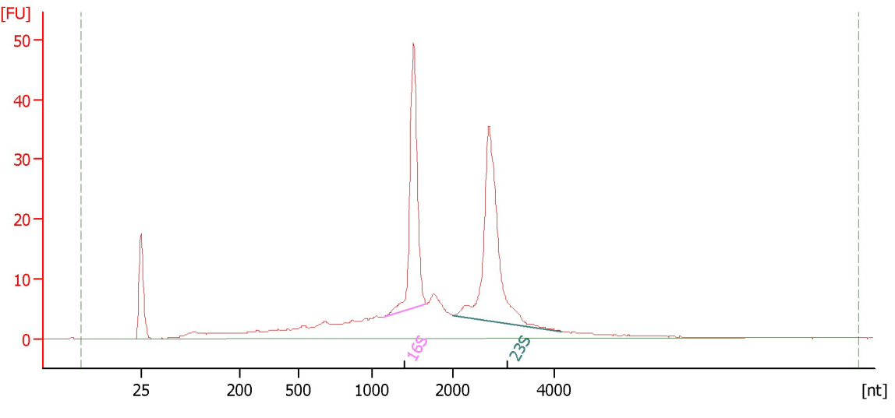
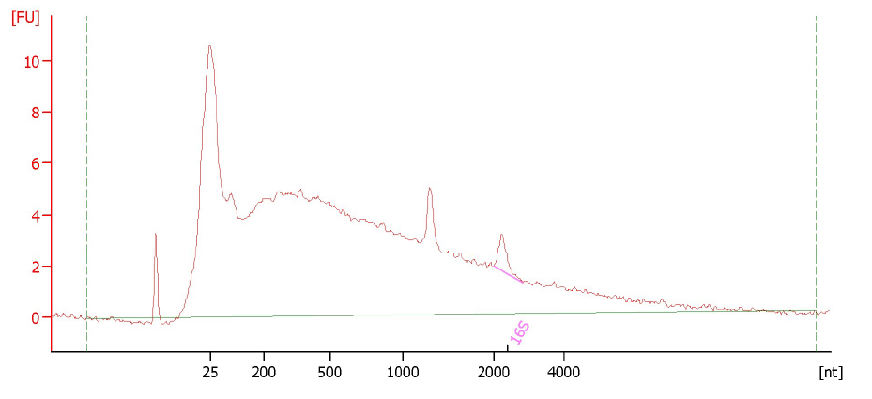
Sample QC – RNA
A good RNA trace should be almost flat apart from the two distinct rRNA peaks
(23s & 16s for prokaryotes and 28s & 18s for eukaryotes).
If there is a lot of noise on the trace then this indicates that the RNA has degraded.
← PASS
FAIL →

Slide 11
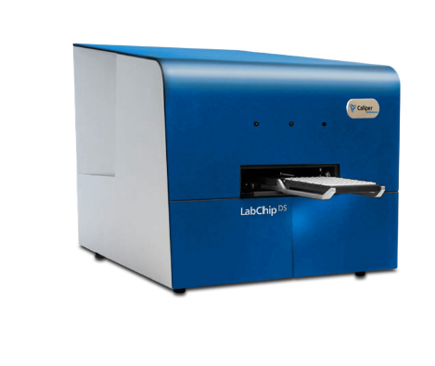
Sample QC
The Perkin Elmer LabChip DS
Nucleic acid concentration measurements
Purity calculations
Measurement of dye labelling of microarray samples
Direct protein calculations
Colour measurements (eg Bradford)
General UV/VIS measurements
Notes:
Bradford Protein Assay
a colorimetric protein assay, is based on an absorbance shift of the dye Coomassie Brilliant Blue G-250 in which under acidic conditions the red form of the dye is converted into its bluer form to bind to the protein being assayed.
The (bound) form of the dye has an absorption spectrum maximum historically held to be at 595 nm.

Slide 12
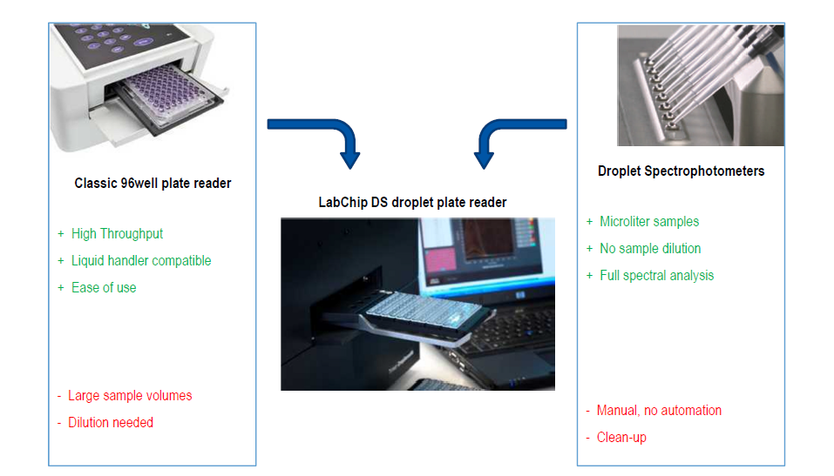
LabChip DS Technology

Slide 13
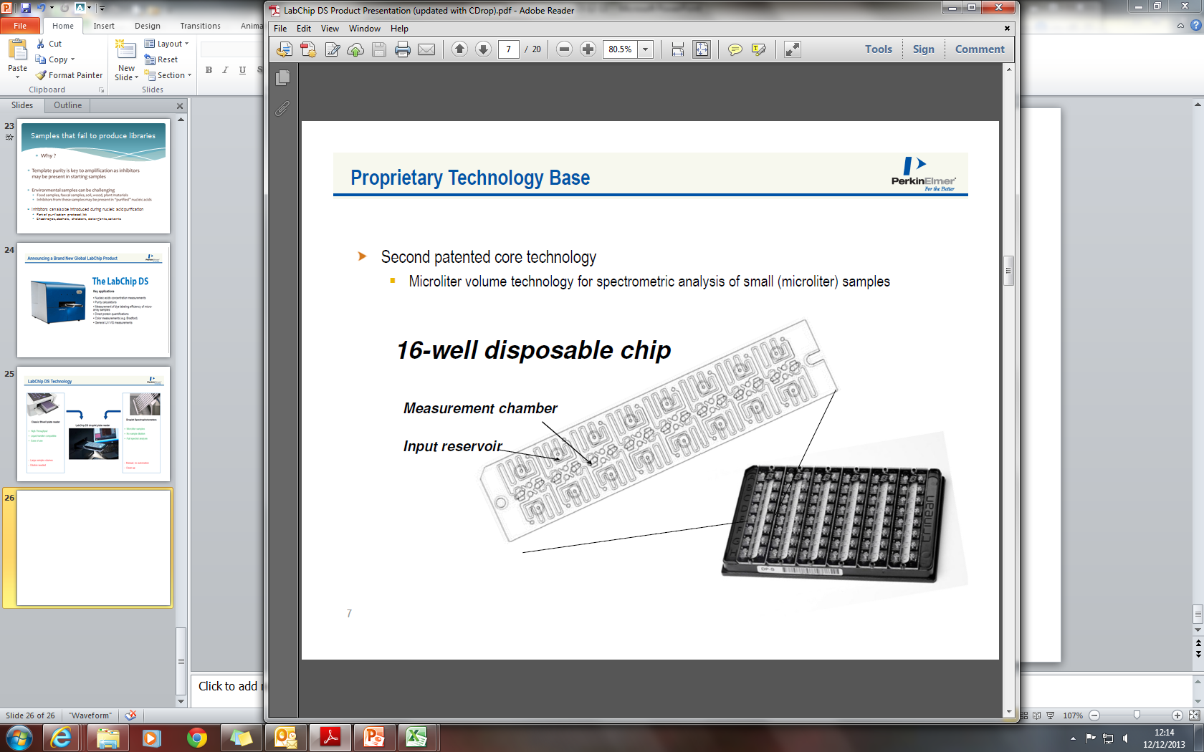
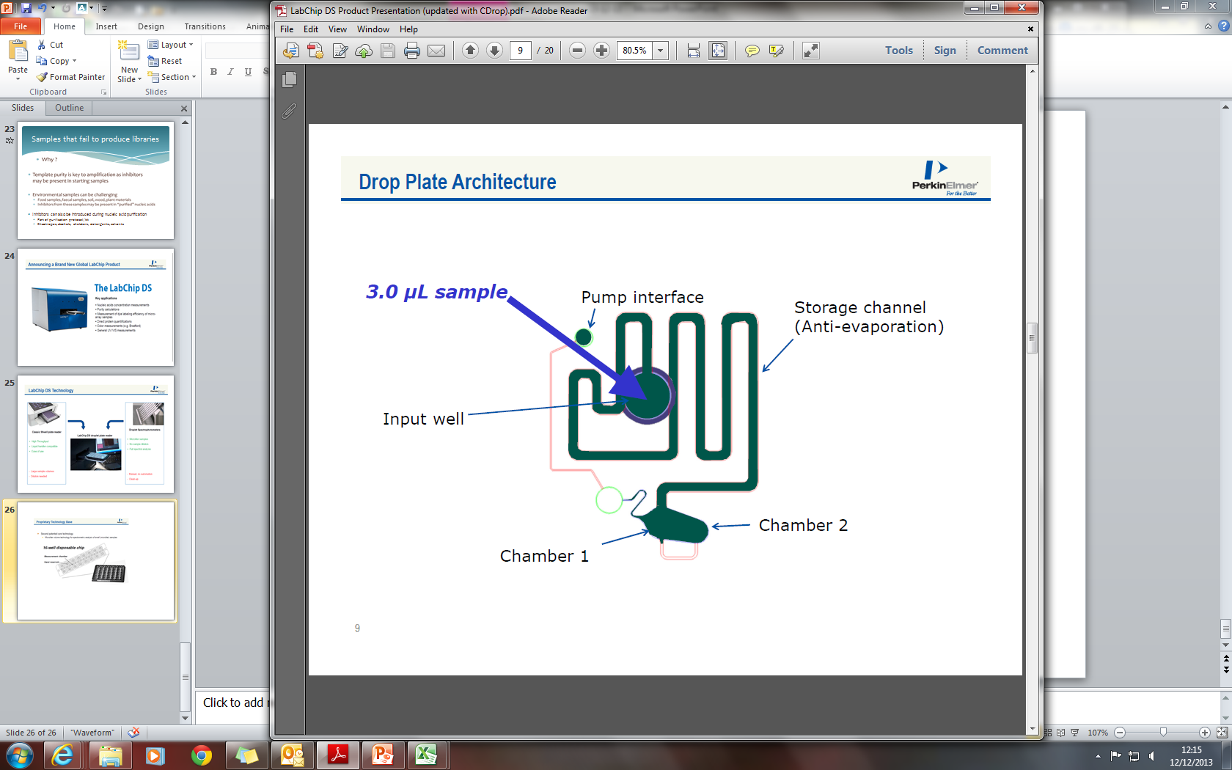
LabChip DS Technology
One measuring chamber
3µl of sample
Fast reading (4 min for 96 samples)
Available in 16-well chip format
Available in 96-well plate format

Slide 14
LabChip DS Technology
Before using the Drop Sense make sure that you know:
what the DNA is re-suspended in
how the DNA was extracted
Quality is determined by the 260/230 and 260/280 ratios:
260/280 ratios should be around 1.8. If the ratio is appreciably lower in either case, it may indicate the presence of protein, phenol or other contaminants that absorb strongly at or near 280 nm.
260/230 ratios should be around 2.0-2.2. If the ratio is appreciably lower than expected, it may indicate the presence of contaminants which absorb at 230 nm.
The trace must also be looked at to determine quality, however, if the trace is unusual then the ratios usually reflect this - and vice versa.
If either the traces and/or ratios look poor then the Drop Sense is also able to detect specific contaminants.

Slide 15
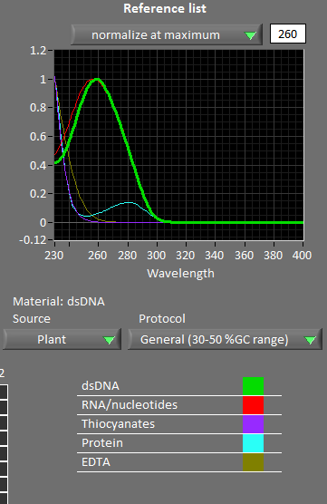
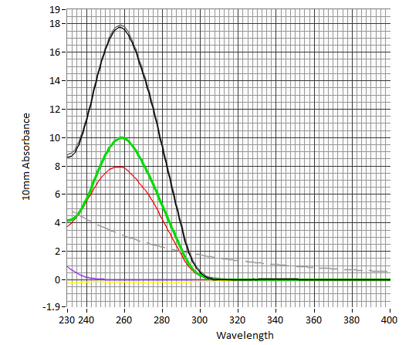
LabChip DS Technology
Based on the extraction method, the C-Drop software will compare possible contaminants to the sample trace:
Individual Sample Trace
Reference Trace from C-Drop

Slide 16
Library construction
Illumina Library Construction
Automated Library Construction
PacBio Library Construction
Sample QC
Application
Portfolio

Slide 17
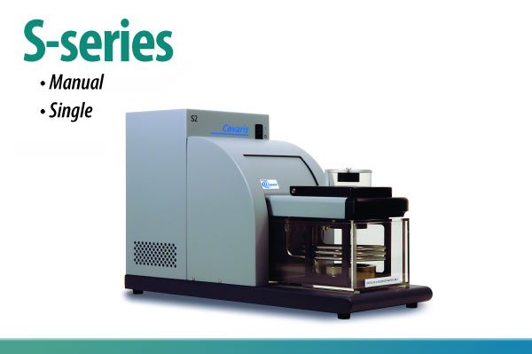
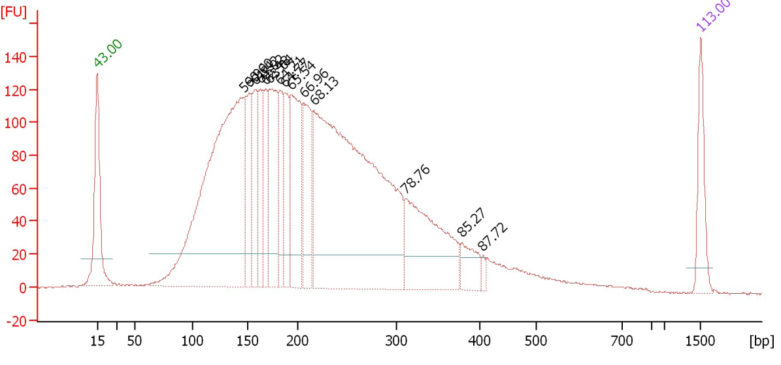
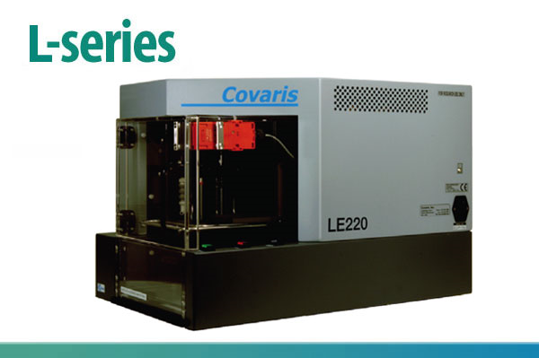
Library Construction
ShS Shear sample with Covaris
- One sample at a time
- One size at a time
- 1 to 96 samples
- Can do 4 to 8 different sizes in the same plate

Slide 18
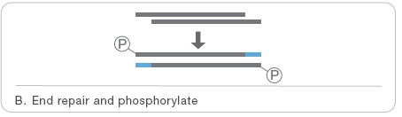
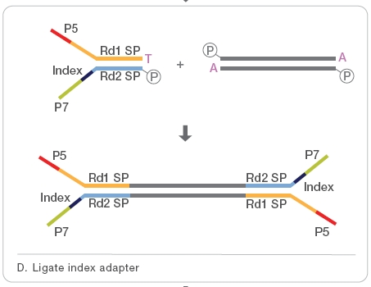
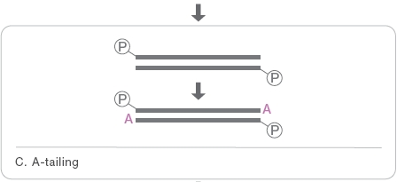
Library Construction – Illumina
Size Selection

Slide 19
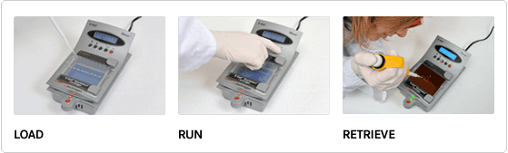
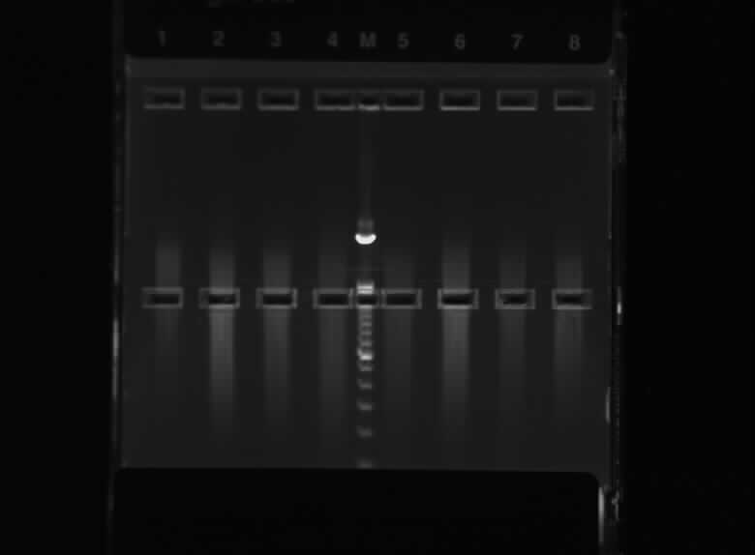
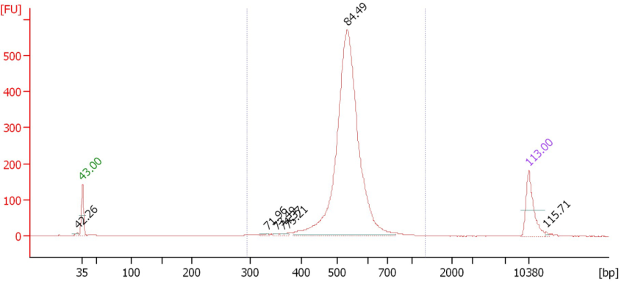
Size Selection – E-gel
Loading wells
Collection wells

Slide 20
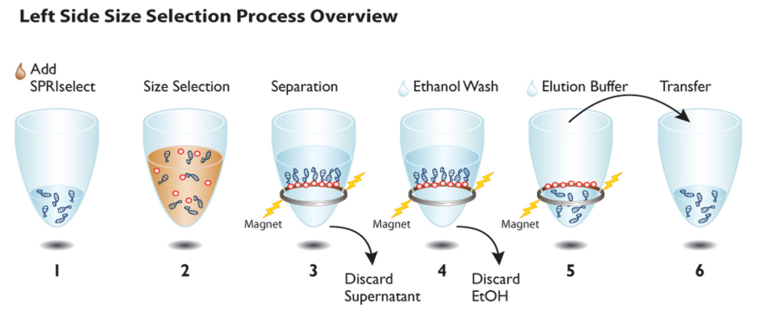
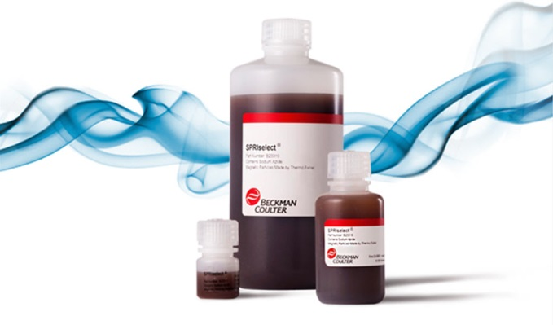
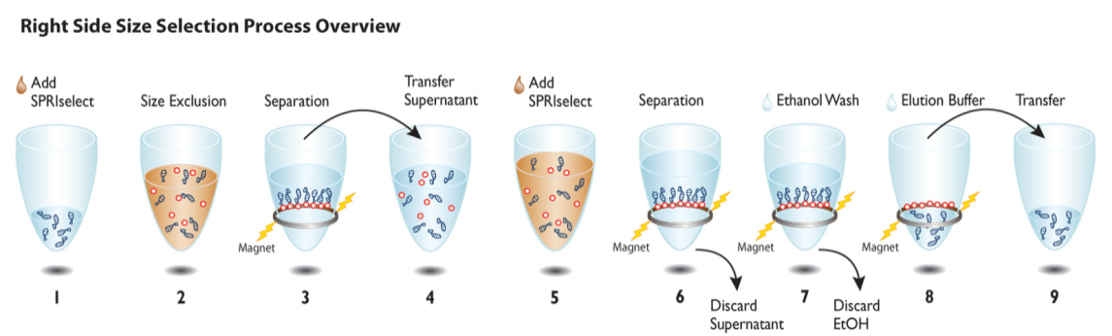
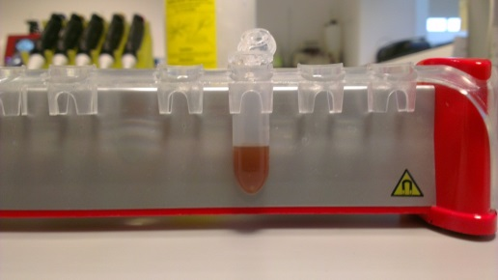
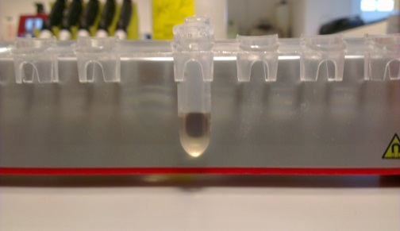
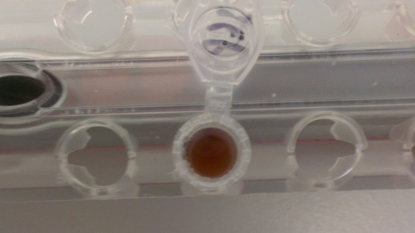
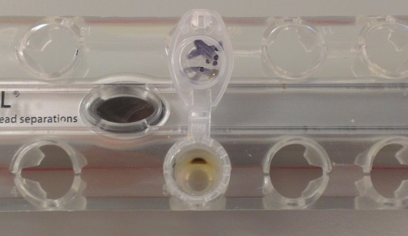
Size Selection – Magnetic Beads
Notes:
SPRIselect is a SPRI-based chemistry that speeds and simplifies nucleic acid size selection for fragment library preparation for Next Generation sequencing. In this process, size selection is required to produce a uniform distribution of fragments around an average size. Using SPRIselect, the size distribution can be adjusted to suit the application and platform used. The process can be scaled for low to high throughput workflows. The guidance provided below can be used to optimize the desired size selection range. Used manually or automated on a liquid handling system such as the Biomek Laboratory Automation Workstation, SPRIselect will provide rapid and consistent size selection suitable for most applications.
Tunable from 150 to 800 base pairs
Left-side size selection Excludes fragments below target cutoff.
Right-side size selection Excludes fragments above target cutoff.
Double size selection Excludes fragments above and below target cutoffs. Captures a targeted region of specific fragment sizes.

Slide 21
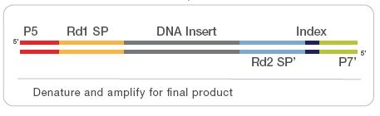

Library Construction – Illumina
Size Selection

Slide 22
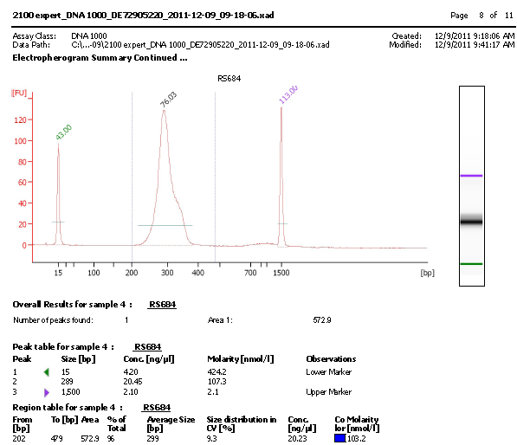
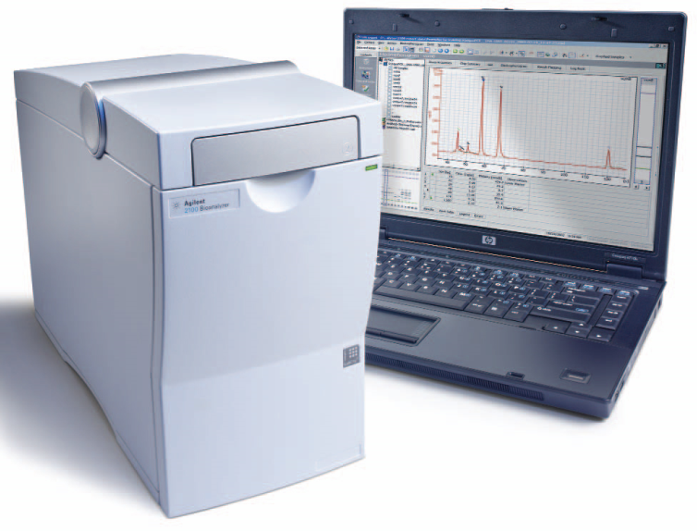
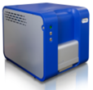
Library QC
Agilent BioAnalyser
Perkin Elmer GX

Slide 23
Improvements
Improving current protocols
Decreasing the starting input material
Increasing the level of multiplexing
Developing more applications on Robotics system
Improving methods for better assemblies

Slide 24
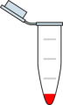
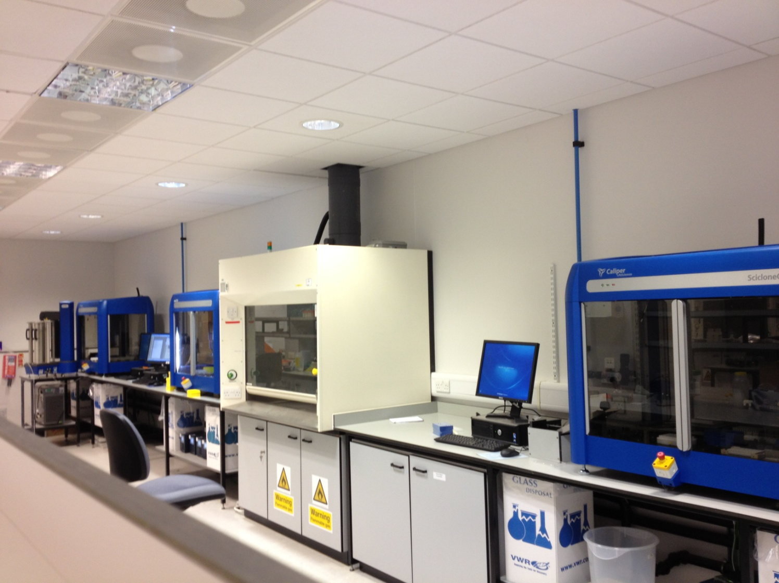
Scalability
1 person can make up to 12 DNA Libraries in 1 Day
PerkinElmer Sciclone NGS
can make 96 DNA Libraries in 1 Day

Slide 25
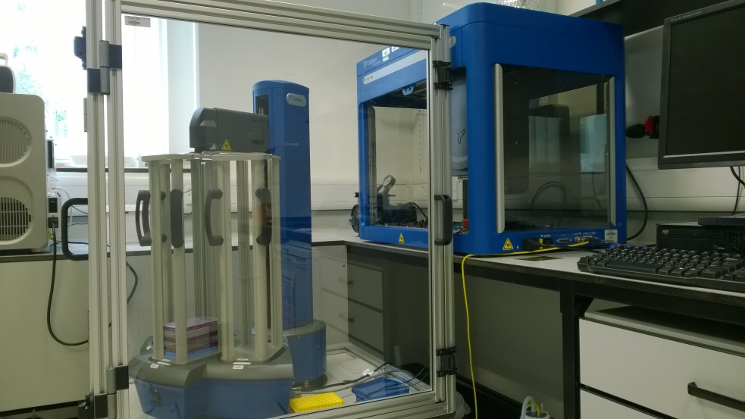
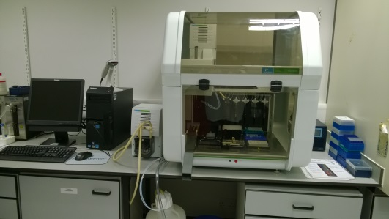
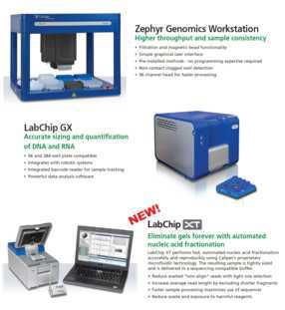
Perkin Elmer Platforms at TGAC
3 x Sciclone NGS Workstations
Automated library construction
Zephyr with Twister 2
Post PCR clean up, GX and plate reader set up
NGS Express
Small scale Nextera XT
Pre-Library Normalisation
LabChip XT
Automated DNA Fractionation and Sizing
LabChip GX
Library QC for DNA, RNA and HMW DNA

Slide 26

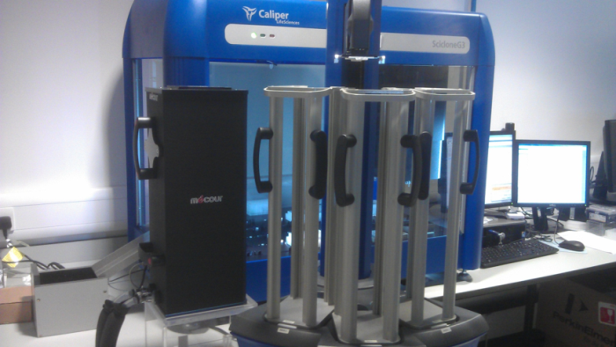
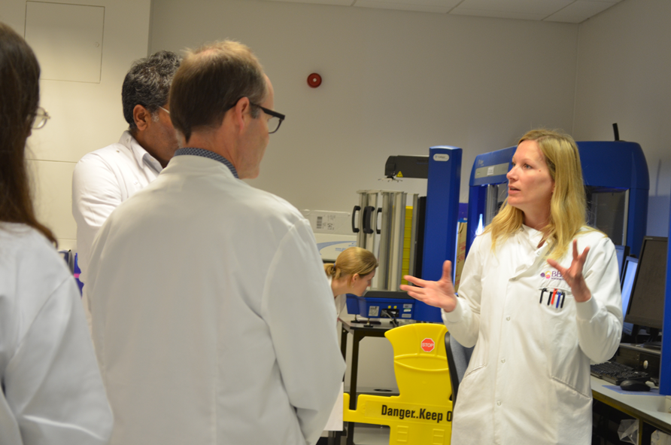
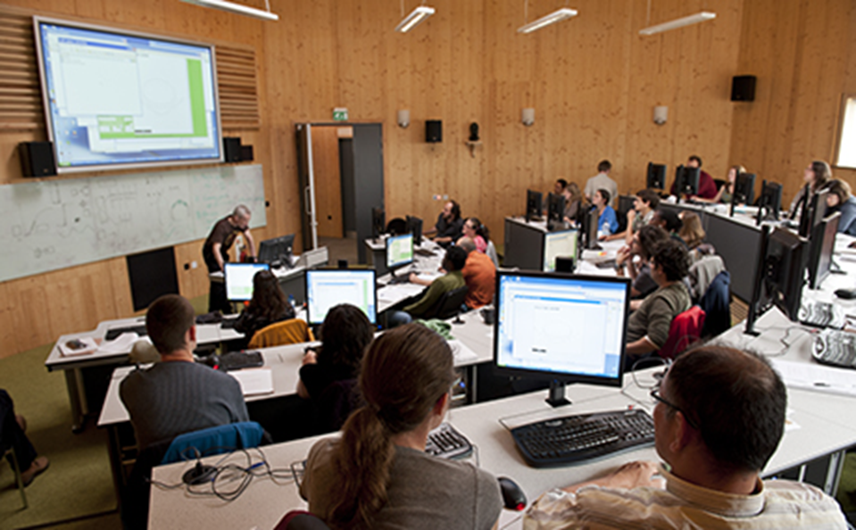

Perkin Elmer Platforms at TGAC
TGAC is the European Reference Site for Perkin Elmer
Suite of Perkin Elmer instrumentation
Gold Standard protocols
Bespoke methods
Enhanced programming
Training workshops
Visits and Tours

Slide 27
Perkin Elmer Platforms at TGAC
Current automated protocols carried out on Perkin Elmer
instrumentation at TGAC:
Illumina Truseq RNA
Illumina Truseq DNA
Illumina Nextera XT
NimbleGen SeqCap EZ Target Enrichment
Agilent SureSelect
Bead based size-selection
Library normalisation
Library pooling
Quality Control assay set up
In development…..
Illumina Small RNA
Bisulphite

Slide 28
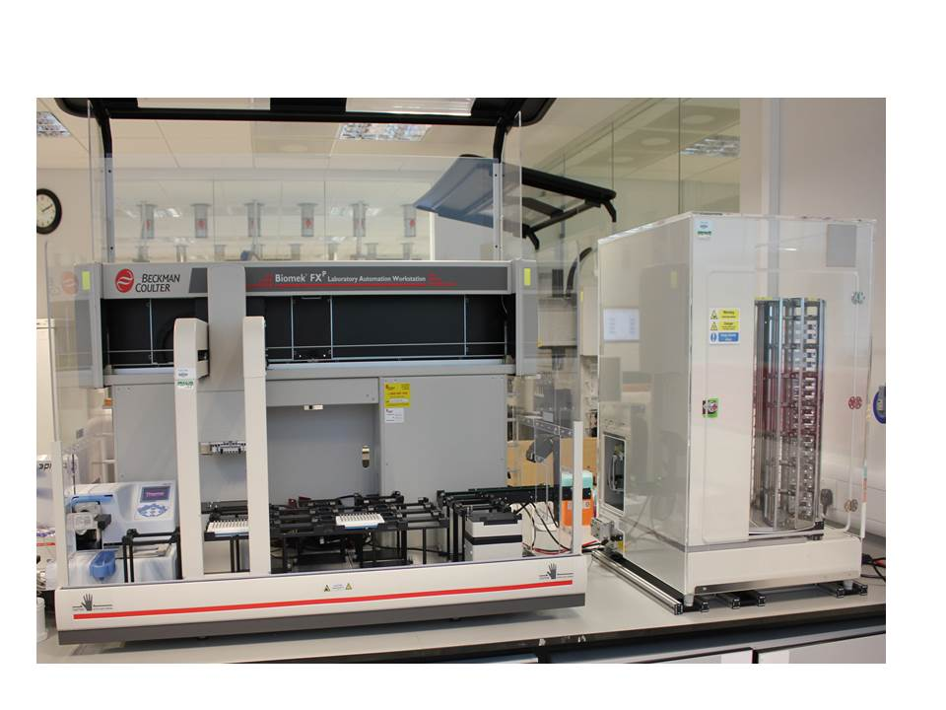
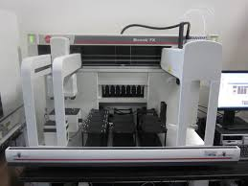
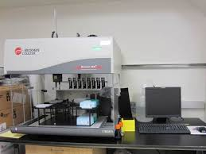
Beckman Coulter Platforms at EI
FX Single Arm + Cytomat
DNA Extraction, Nextera BAC Pipeline,
Alkaline lysis preps
FX Dual Arm
DNA Extraction, Nextera BAC Pipeline,
Alkaline lysis preps
NX
Post PCR normalisation and Pooling, cherrypicking

Slide 29
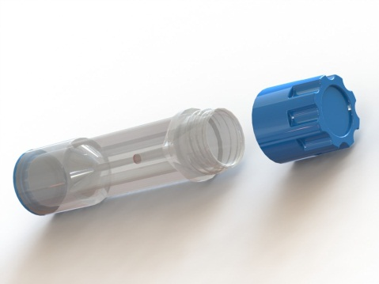
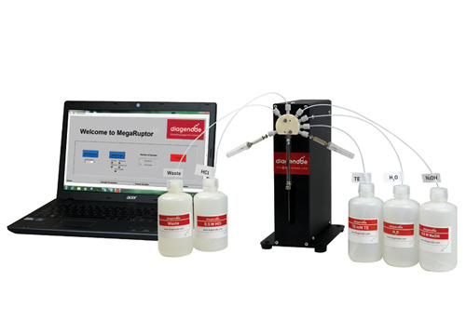
PacBio Shearing
Covaris G-tube
Diagenode MegaRuptor

Slide 30
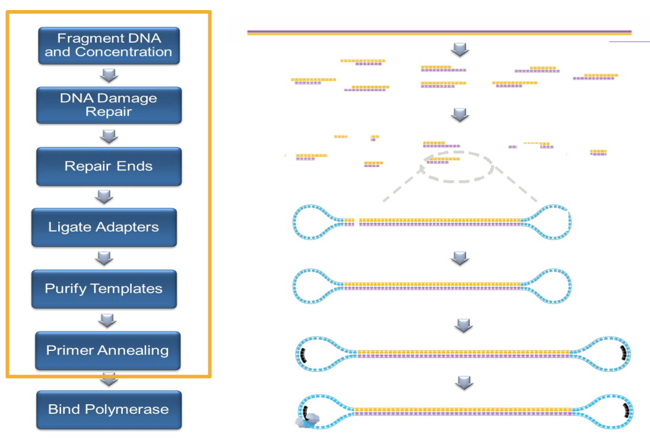
SMRTbell Template Preparation

Slide 31
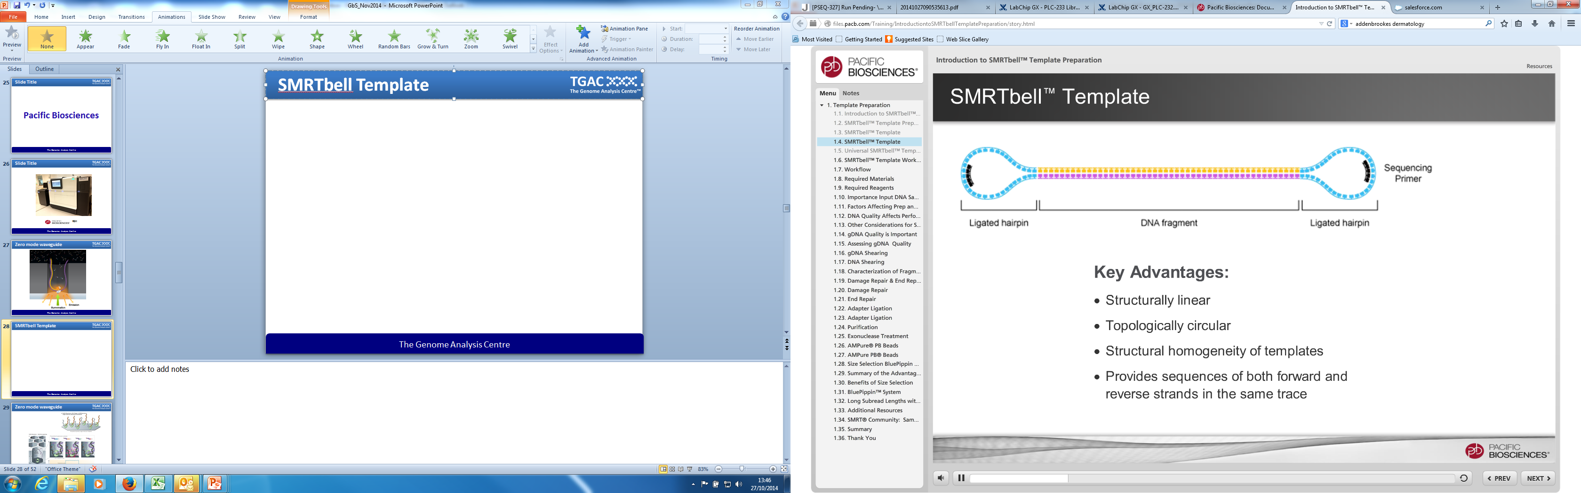
SMRTbell Template Preparation
Advantages
Structurally linear
Topologically circular
Structural homogeneity of templates
Provides sequences of both forward and reverse strand in the same trace

Slide 32
SMRTbell Template Preparation
Advantages
Structurally linear
Topologically circular
Structural homogeneity of templates
Provides sequences of both forward and reverse strand in the same trace

Slide 33
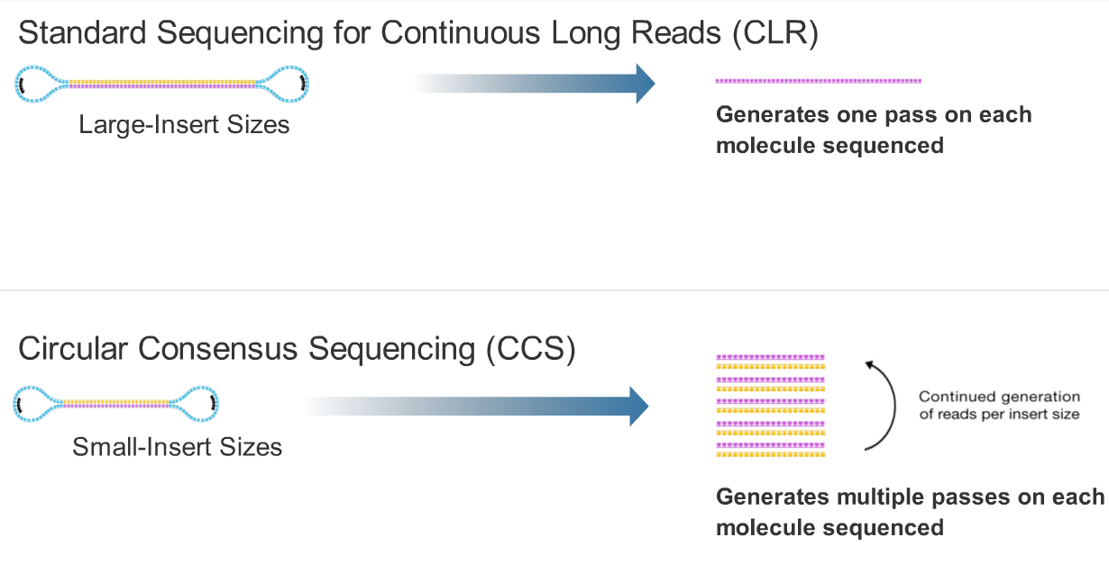
SMRTbell Template Preparation

Slide 34
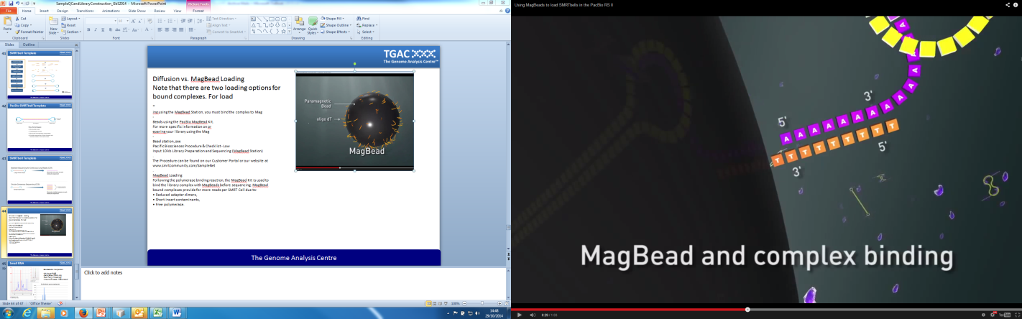
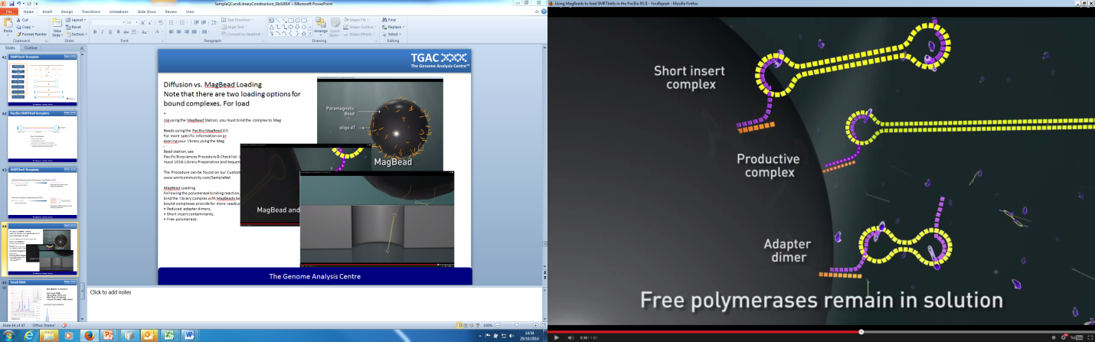
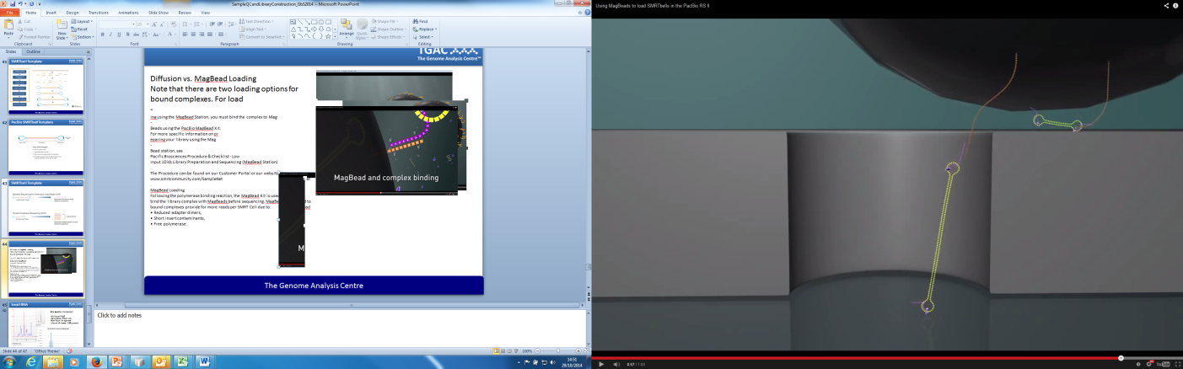
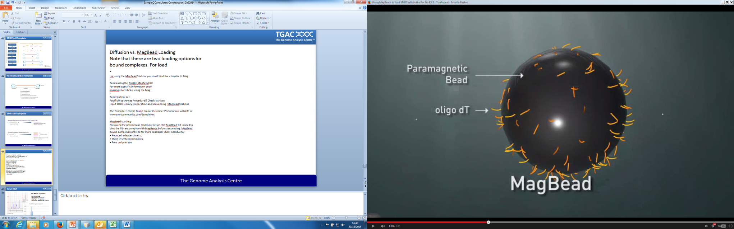
MagBead Loading
Following the polymerase binding reaction, the library complex is bound to MagBeads before sequencing.
MagBead bound complexes provide for more reads per SMRT Cell due to:
• Reduced adapter dimers,
• Short insert contaminants,
• Free polymerase.

Slide 35



Small RNA
Size Selection Comparison:
6% Novex PAGE
Perkin Elmer XT300 chip
Blue Pippin 3% agarose
Ampure XP beads - NEB protocol
Notes:
The 147nt band primarily contains mature microRNA generated from approximately 22nt small RNA fragments.
A second,157nt band containing piwi‐interacting RNAs, as well as some microRNAs and other regulatory small RNA molecules, is generated from approximately 30nt RNA fragments

Slide 36
Applications
DNA Sequencing
De novo genome sequencing
Genome resequencing
Targeted resequencing
Exome sequencing
Amplicon sequencing
CHIP sequencing
Genotyping by sequencing
Restriction site associated DNA sequencing (RADseq)
RNA Sequencing
De novo transcriptome sequencing
Total RNA sequencing
mRNA sequencing
Small RNA sequencing
Low input RNA

Slide 37









































Notes:
Some of the varied organisms that we have had proposals to sequence through the CCC.
Amphioxus
Aphid
Arabidopsis thaliana (thale cress, mouse-ear cress or Arabidopsis)
Asia 1 whitefly
Bluetongue Virus (BTV) insect vector, Culicoides sonorensis
Brassica
Broad Bean (mammoth Vicia faba ) diploid plant genome (Magnoliophyta)
Chicken
chloroplast genomes
Chloroplasts in Arabidopsis
Common Carp, Cyprinus carpio
Dairy Cattle
Fasciola hepatica
feline immunodeficiency virus.
fission yeast
Fragilariopsis cylindrus
Heterocephalus glaber, the naked mole-rat
human urothelium
influenza virus (ferrets/horses)
Listeria monocytogenes
Medicinal maggot
Mice
midgut transcriptome of five key beetles
miniature dachshund (MD) dog
Miscanthus
Nannochloropsis
oat
Passion-flower butterflies (Heliconius erato)
Pea Pisum sativum
perennial ryegrass (Lolium perenne)
Physcomitrella patens
Plant pathogenic fungus Colletotrichum acutatum
Pseudomonas. aeruginosa
red clover (Trifolium pratense )
Silene latifolia genome (White Campion)
the arbuscular mycorrhizal fungus Glomus intraradices
The Common cuttlefish, Sepia officinalis
The 'immortal jellyfish',
Tomato
Turkey
viral sequences from canine liver samples
wheat
Willow

